Slide 1

FlickPicks: Personalized Movie Recommendations using Collaborative Filtering
Submitted by:
V.Gayathri
S.Likhitha
S.Kalyani
T.Hanish Manikanta

Slide 2
ABSTRACT
A recommendation system is a type of information filtering system which attempts to predict the preferences of a user, and make suggests based on these preferences. There are a wide variety of applications for recommendation systems.
These have become increasingly popular over the last few years and are now utilized in most online platforms that we use. The content of such platforms varies from movies, music, books and videos, to friends and stories on social media platforms, to products on e-commerce websites. There are different types of recommender systems using association rules.
In this project, we are using collaborative filtering. It is a machine learning approach that makes use of the information provided by users, analyzes them and then recommends the movies that is best suited to the user at that time, it is based on cosine similarity.

Slide 3
INTRODUCTION
Recommender systems aim to predict users’ interests and recommend items that quite likely are interesting for them
In this project we have two data sets. They are: 1. Movie dataset: this dataset contains movie id & title.
2. Ratings dataset: all ratings are contained in the file ratings.Csv.
User-based collaborative filtering is also called user-user collaborative filtering. It is a type of recommendation system algorithm that uses user similarity to make product recommendations.

Slide 4
PROBLEM STATEMENT
For any given product there are sometimes thousands of options to choose from. Think of the examples i.e., Streaming videos, social networking, online shopping and the list goes on.
Recommender system helps to personalize a platform and help the user find something they like. To search for an movie name it takes too much of time, here by using recommender system the user can finds the movie name which is best by using content based filtering.
This may be sometimes useless for the users who have different taste from the recommendations shown by the system as every user may have different tastes and it is less efficient. This problem was overcome by the collaborative filtering.

Slide 5
SOLUTION FOR PROBLEM STATEMENT
The recommendation system that recommends different things to users. This system will recommend movies to users. This system will provide more precise results.
The existing system works on individual users rating. This may be sometimes useless for the users who have different taste from the recommendations shown by the system as every user may have different tastes. This proposed system le., Collaborative filtering calculates the similarities.
Between different users and then recommend movie to them as per the ratings given by the different users of similar tastes. This will provide a precise recommendations to the user by using c cosine similarity.
It provides services to user to rate movies, see recommendations put comments and similar movies.

Slide 6
EXISTING SYSTEM
Association rules:
Association rule mining is the task of identifying patterns in basket data transactions that possibly consist of multiple items. The aim of this thesis is to better understand the applications of association rule mining for recommender systems.
Content based recommender system: A content-based recommender learns a profile of the new user’s interests based on the features. Present, in objects the user has rated. In a content-based recommender system the algorithms used are such that it recommends users similar items that the user has liked in the past or is examining currently.

Slide 7
Utility based recommender system:
Make suggestions based on a computation of the utility of each object for the user. In utility based system, every industry will have a different technique for arriving at a user specific utility function and applying it to the objects under consideration. Knowledge based recommender system:
Knowledge based recommendation works on functional knowledge: they have knowledge about how a particular item meets a particular user need, and therefore reason about the relationship between a need and a possible recommendation. DEMOGRAPHIC BASED RECOMMENDER SYSTEM: this system aims to categorize the users based on attributes and make recommendations based on demographic classes. The benefit of a demographic approach is that it does not require a history of user ratings like that in collaborative and content based recommender system.

Slide 8
PROPOSED SYSTEM
User-based collaborative filtering recommendation
User-based collaborative filtering makes recommendations based on user-product interactions in the past. The assumption behind the algorithm is that similar users like similar products.
User-based collaborative filtering algorithm usually has the following steps:
Find similar users based on interactions with common items.
Identify the items rated high by similar users but have not been exposed to the active user of interest.
Calculate the weighted average score for each item.
Rank items based on the score and pick top n items to recommend.

Slide 9
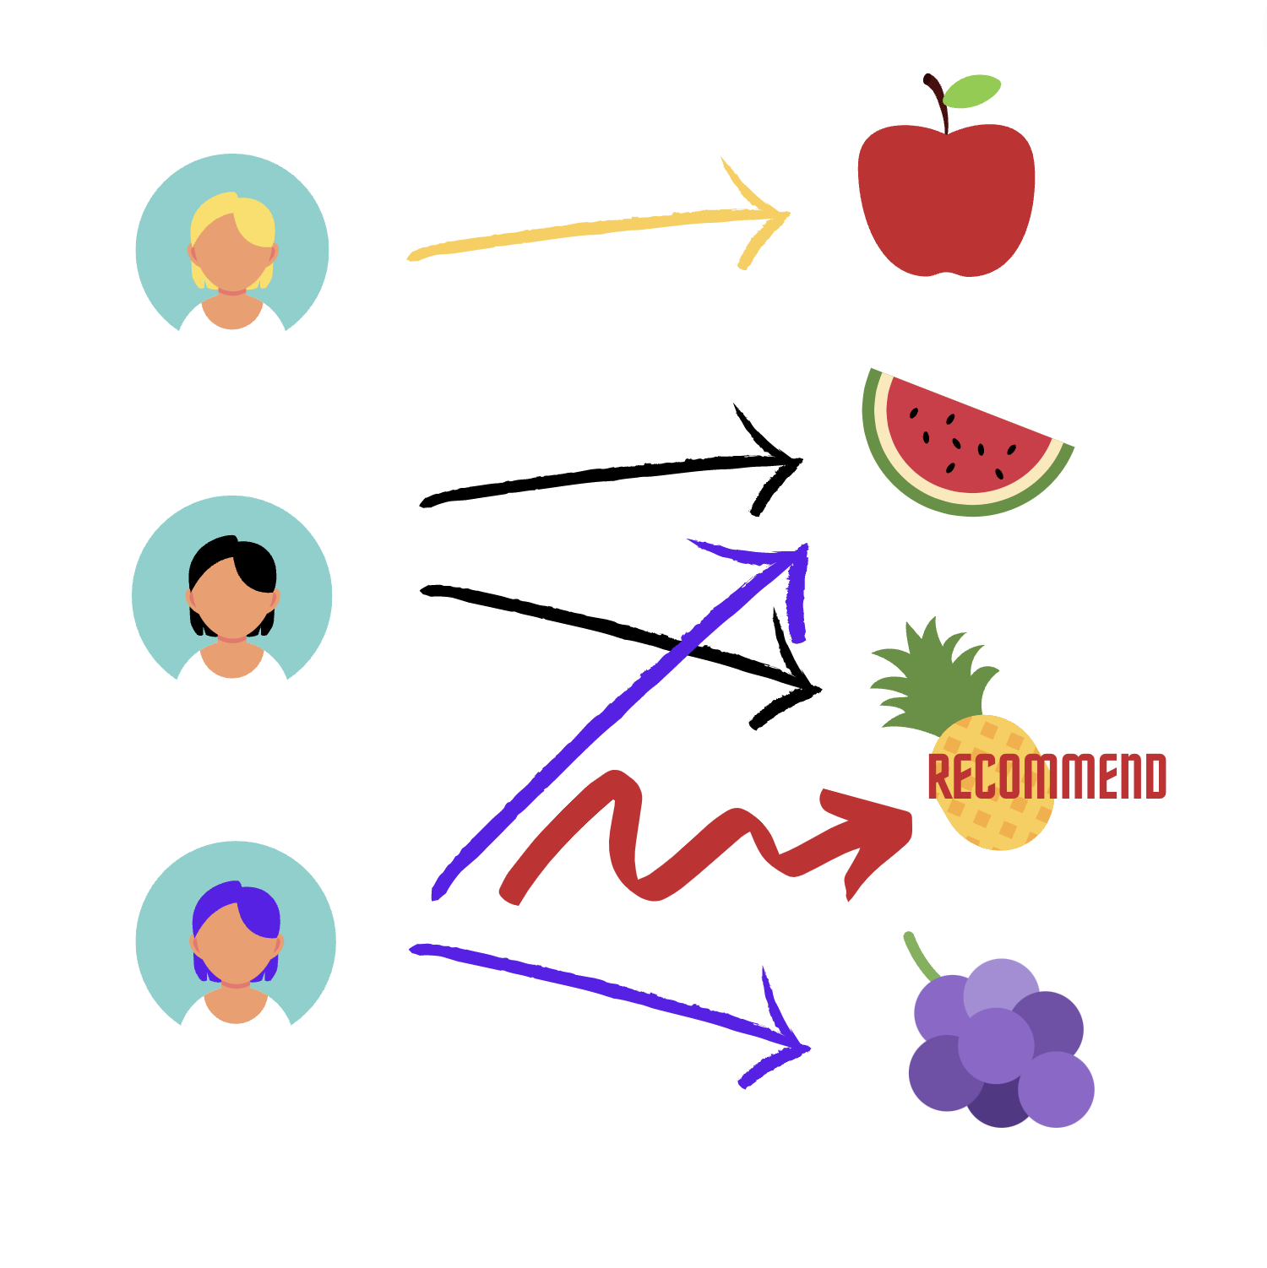

Slide 10
SYSTEM REQUIREMENTS
SOFTWARE REQUIREMENTS:
Language : Python
Framework : Scikit Learn/Pandas/Numpy
IDE : visual Studio code
HARDWARE REQUIREMENTS:
Processor : Core I3
RAM : 4 GB
Hard Disk : 340 GB

Slide 11
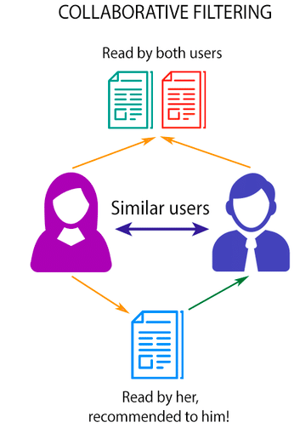
COLLABORATIVE FILTERING

Slide 12
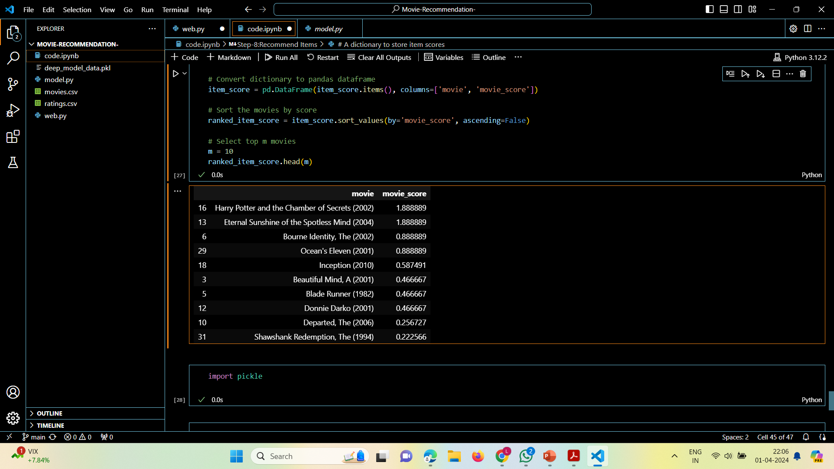
RESULT

Slide 13
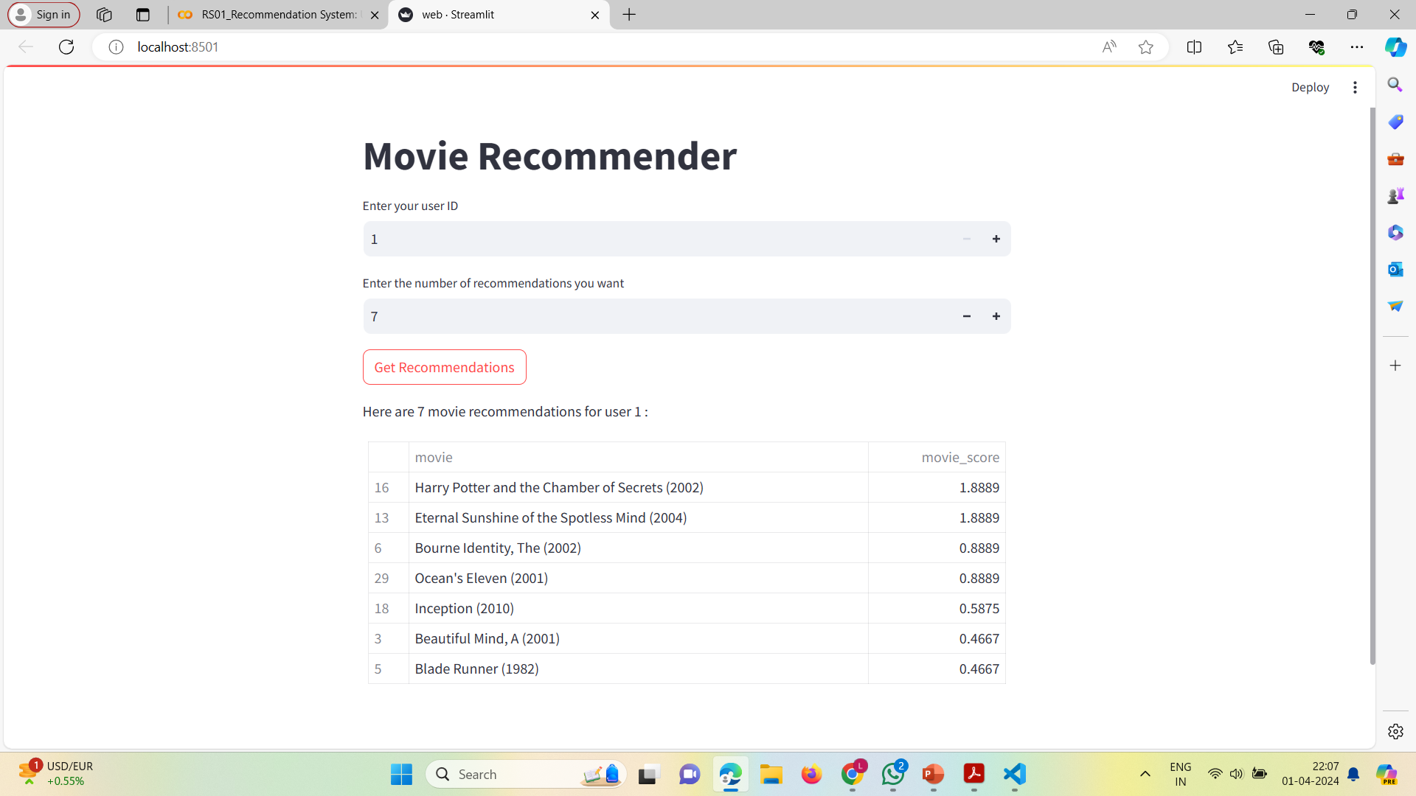

Slide 14
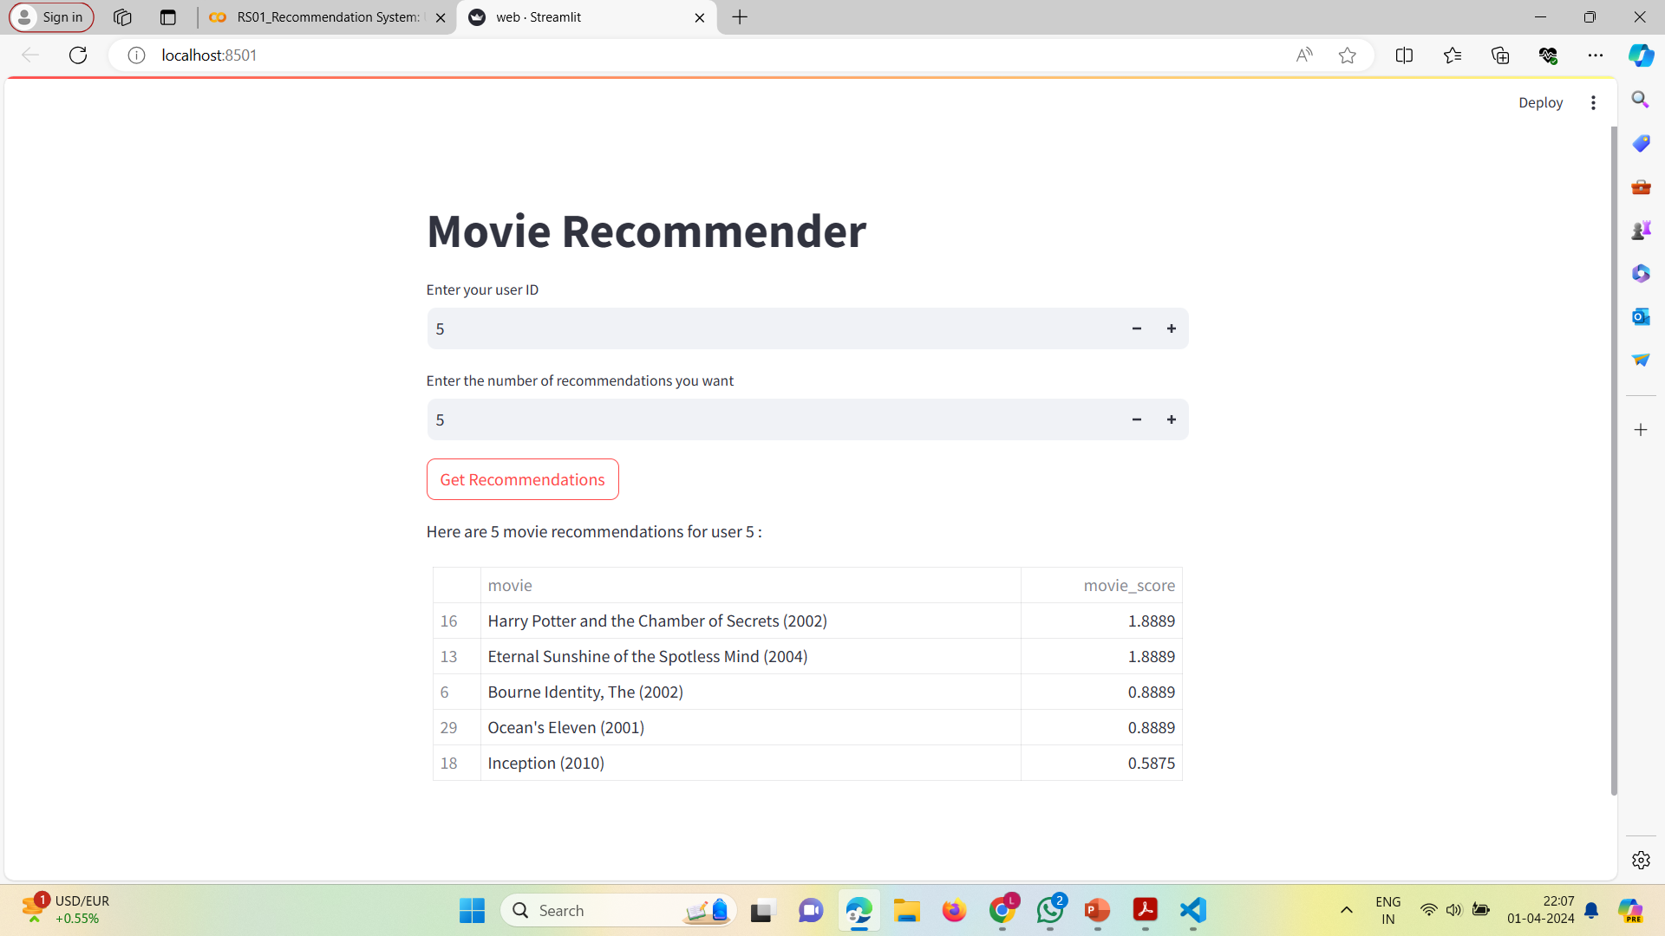

Slide 15
ADVANTAGES
Advantages:
No domain knowledge necessary:
We don't need domain knowledge because the embeddings are automatically learned.
Serendipity:
The model can help users discover new interests. In isolation, the ML system may not know the user is interested in a given item, but the model might still recommend it because similar users are interested in that item.

Slide 16
CONCLUSION
To avoid the use of content based filtering, the user-based CF approach is used for obtaining better results.
Collaborative filtering is the most successful and popular algorithm in the recommender system’s field. It helps customers to make a better decision by recommending interesting items.
This system reflects our preference and exposes us to a border range of choices based on similar user’s taste ,it recommend movie as per the ratings given by the different users of similar tastes.

Slide 17


